Slide 1
CSE 5912
Student Presentations
By: Matt Boggus

Slide 2
Overview
Timebox presentations
  Logistics
  Technology component
Stand-up meetings
General presentation advice
End of semester presentations

Slide 3
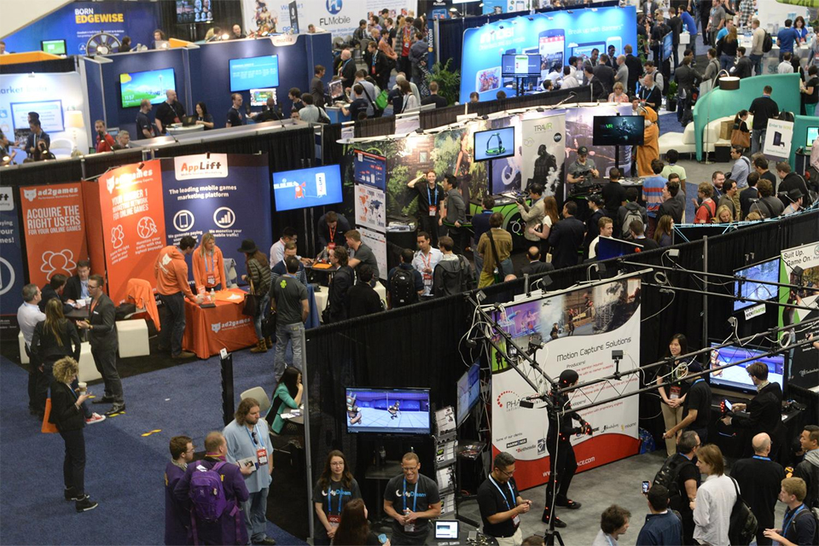
Timebox presentations
(as a pitch to publisher)
Related Gamesradar article link
Notes:
Image source: https://www.animationmagazine.net/wordpress/wp-content/uploads/GDC-post-2.jpg

Slide 4
Sp’23 timebox presentation logistics
(tentative plans)
For timebox 1
  20-30 minutes presenting/selling progress – features and code
  Stand-up meeting with instructor afterward
For timebox 2 and onwards,
  May use the entire 55 minutes of class
    Plan to still use 20-30 minutes for presenting/selling progress
    Additional time going deeper on technical components as you see fit
  Stand-up meeting with instructor on an earlier or later day
Each team will give 4-5 timebox presentations, everyone must have a speaking part at least twice over the semester
Each presenter will be assessed by 2-3 students from other teams using the capstone presentation rubric

Slide 5
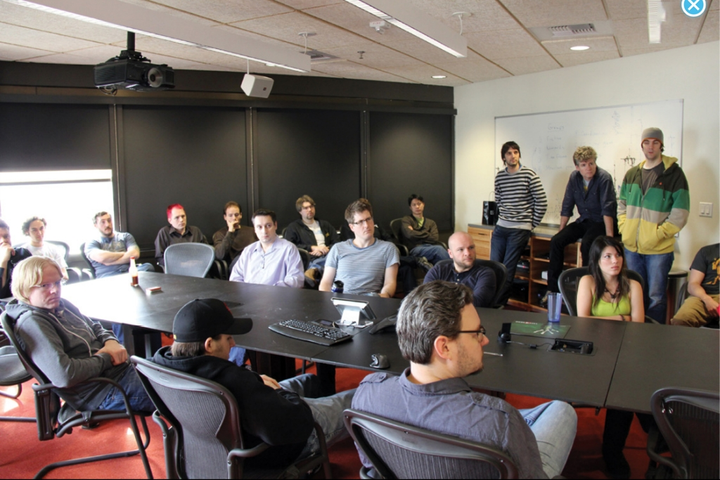
Post-timebox stand-ups
(as a stakeholder meetings)
Notes:
Image source - https://retrogamesappreciation.wordpress.com/2012/05/16/the-ins-and-outs-of-video-game-design-part-2/
Content should be similar to a SCRUM standup meeting
Present what your team accomplished
Present any technical problems encountered (especially if still unresolved)
Present what your team plans for the next timebox

Slide 6
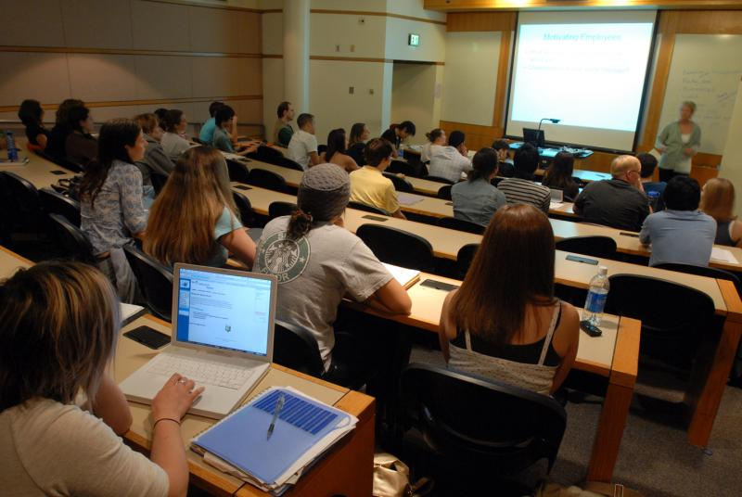
Presenting technology component(s)
Notes:
Image source - https://www.pdx.edu/cse/cse-courses

Slide 7
Presenting technology results
Think of this as teaching material you might find in a 3000+ level CSE class
Various format options
  Compare/contrast of algorithms/techniques
  Code sample walkthrough or discussion
  Tutorial
  Demonstrations
Practice in advance, time yourself so that you know it’ll fit in the time available

Slide 8
Technology presentation goal(s)
Demonstrate a thorough understanding of the topic
Demonstrate the ability to think and communicate like:
  a scientist
    Provide enough details for your algorithm (or in this case the one you learned on your own) to be implemented by another expert
  or an engineer
    Provide a thorough examination of two or more ways to solve a problem so that another expert can select the better solution for a given set of constraints

Slide 9
General presentation advice

Slide 10
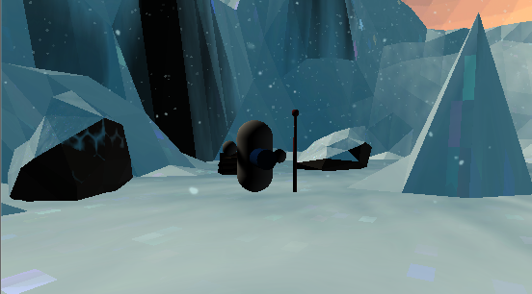
Presentation advice: show don’t tell
Image on slide “AI Vision” by team Supa Cool (Sp’15)
Alternative text explanation
We added vision checks for AI enemies
  Raycasts go out from center of capsule
  If all raycasts hit scene geometry first, …
  If a raycast hits a player, …
  Etc.
Notes:
Explain the parts of each image that are related to your current topics

Slide 11
General presentation advice
In the introduction, state
  What is the problem?
  Why is it important?
  How is the problem addressed?
  To explain complex ideas or data, use the Particular General Particular (or PGP) method
  Demo your game and discuss easily understood content (gameplay)
  Go through a slide set with an overview of the gameplay and more details on the less easily understood content (technical features)
  Demo again and point out examples of the technical features in action

Slide 12
General presentation advice
Practice giving the talk once beforehand
  Ensures all team members work is understood and included
  Can catch nervous ticks or word repetition
  Timing will be very important for the technology talks
Set up early
  Plugging in one of your laptops
  The podium touchpad and projector user interface take some getting used to
Finish early when possible
  Allows for questions
  Ending on a high note will leave the audience wanting more

Slide 13
Additional tips for Timeboxes
After a brief introduction, open with demoing your current build
Do not spend too much time on the “easy” parts
  Game design, controls, art assets, etc.
Make or draw diagrams for the “hard” parts
  State machines (game, player, etc.), AI logic, level generation, etc.
End with another demo to give the audience a second look at the results and ask more specific questions

Slide 14
End of semester presentation

Slide 15
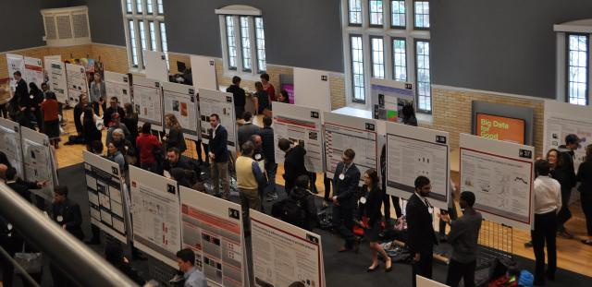
Poster presentation
Notes:
Image source: https://ugresearch.osu.edu/sites/default/files/styles/max_640x640/public/images/2021-11/Denman%202.jpg?itok=sH9ZmfT2

Slide 16
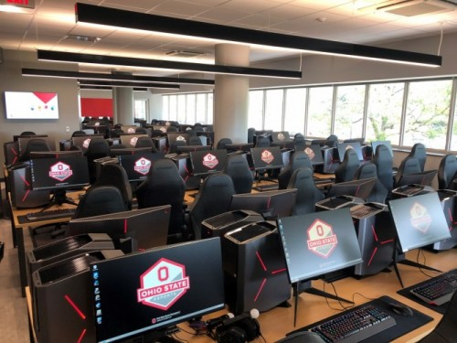
Demo and playtesting session
Notes:
Image source: https://presspage-production-content.s3.amazonaws.com/uploads/2170/500_ohiostateesportsarena-855315.jpg?x=1568234339646

